Slide 1
SPORTS GROUND MANAGEMENT SYSTEM
Prepared BY :VIRAJ MARU(250160450052)

Slide 2
Introduction
The system manages sports ground booking digitally.
Users can register and log in easily.
Users can check ground availability online.
Booking date and time slots can be selected quickly.
Online payment makes booking confirmation easy.
Admin manages grounds, schedules, and bookings.
The system saves time and avoids booking conflicts.

Slide 3
Existing SySTEM
Sports ground booking is managed manually using registers or phone calls.
Real-time availability checking is not available.
Double booking may occur due to manual management.
Users must contact staff or visit manually for booking.
Payment records may contain errors or lost data.
Cancellation and rescheduling are difficult to manage.
Generating booking reports takes extra time and effort.

Slide 4
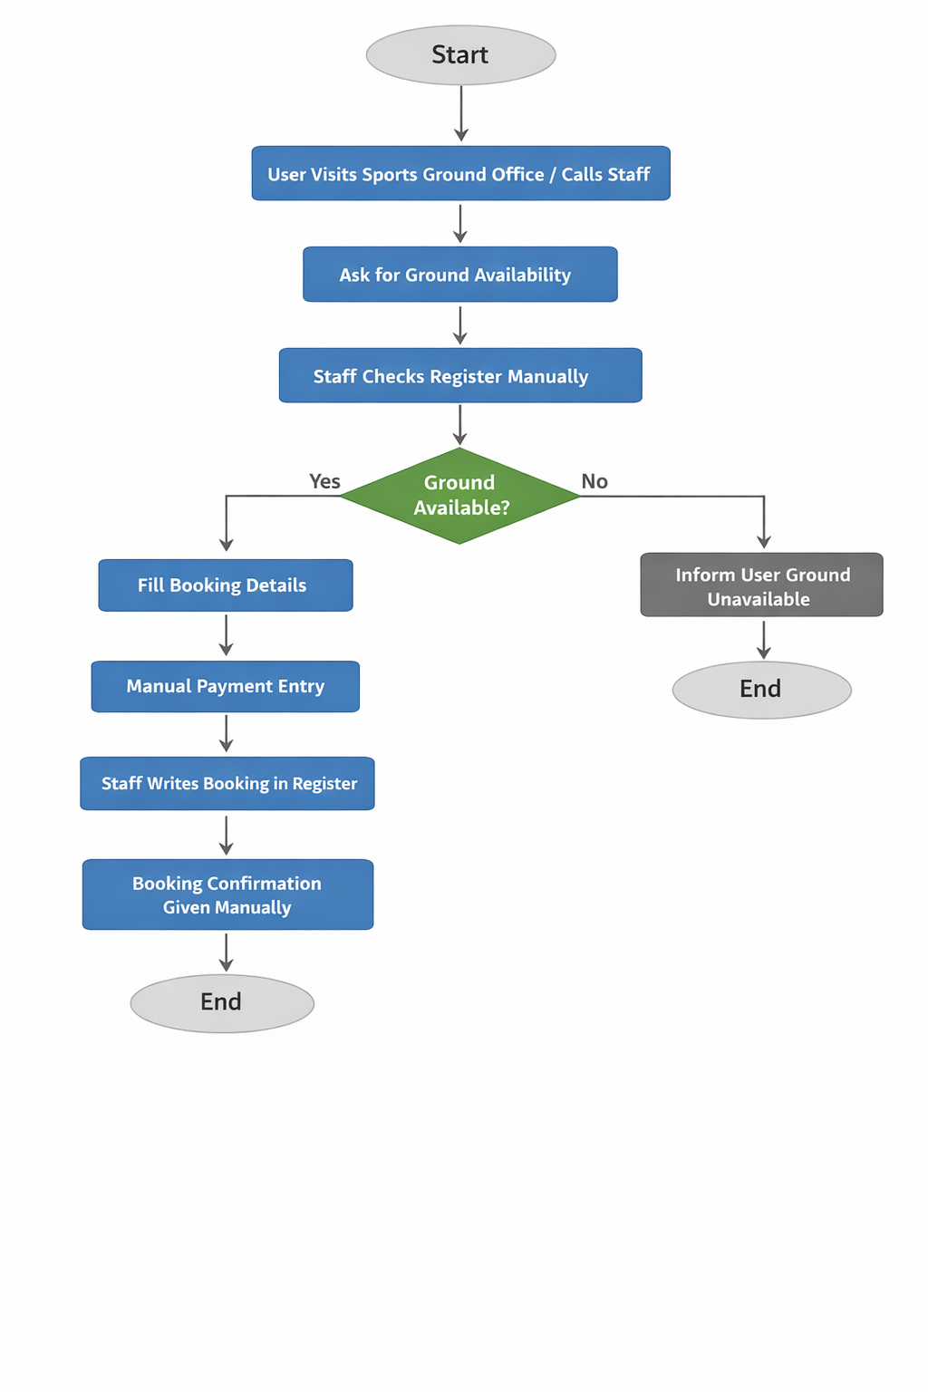
SYSTEM FLOWCHART(EXISTING SYSTEM)

Slide 5
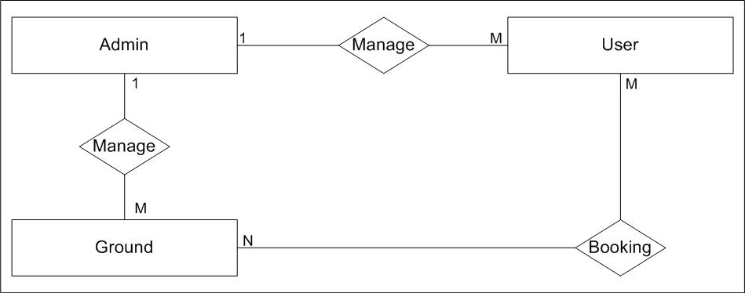
ER DIAGREAM

Slide 6
PROBLEM OF EXISTING SYSTEM
Booking is done manually, so double booking can happen.
Users must visit or call staff to reserve the ground.
Payment records are difficult to maintain manually.
Checking ground availability takes more time and effort.
Managing schedules and user records becomes confusing and error-prone.

Slide 7
Proposed SYSTEM OVERVIEW
It is an online platform for managing sports ground bookings.
Users can check available grounds and time slots.
It allows easy booking for different sports.
The system reduces manual paperwork.
Admin can manage ground details and schedules.
Payment and booking records are stored securely.
It helps prevent booking conflicts and improves efficiency.

Slide 8
SCOPE OF THE SYSTEM
Requires internet connection (network required)
System runs on a web browser (Chrome, Edge, etc.)
• Customers can register, login, view ground, and check ground availability.

Slide 9
Use cases diagram : admin
Admin
Register/Login
Manage Ground
Manage scheduler
Manage Bo
ManageUsers
Booking History
Logout

Slide 10
Use cases diagram : users
Users
Register/Login
Check ground avaliblity
Book ground slot
Manage Bo
Make payment
Booking History
View booking history
xx
Submit feedback

Slide 11
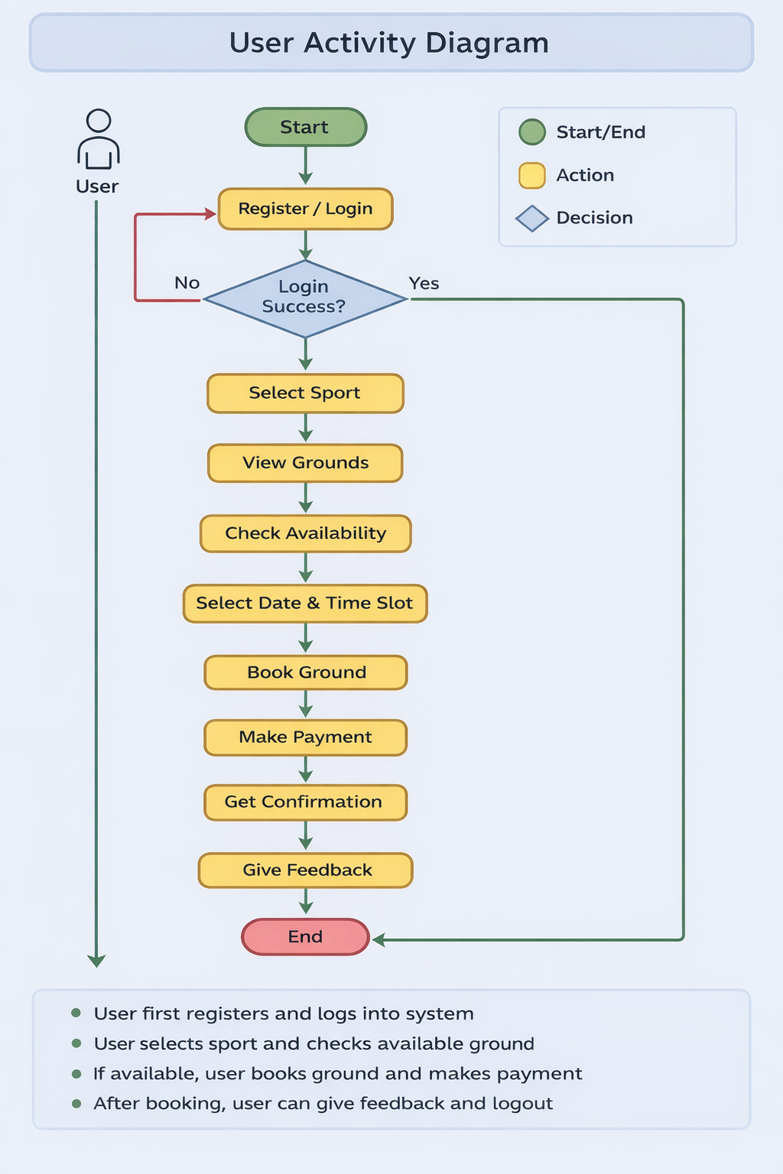


Slide 12
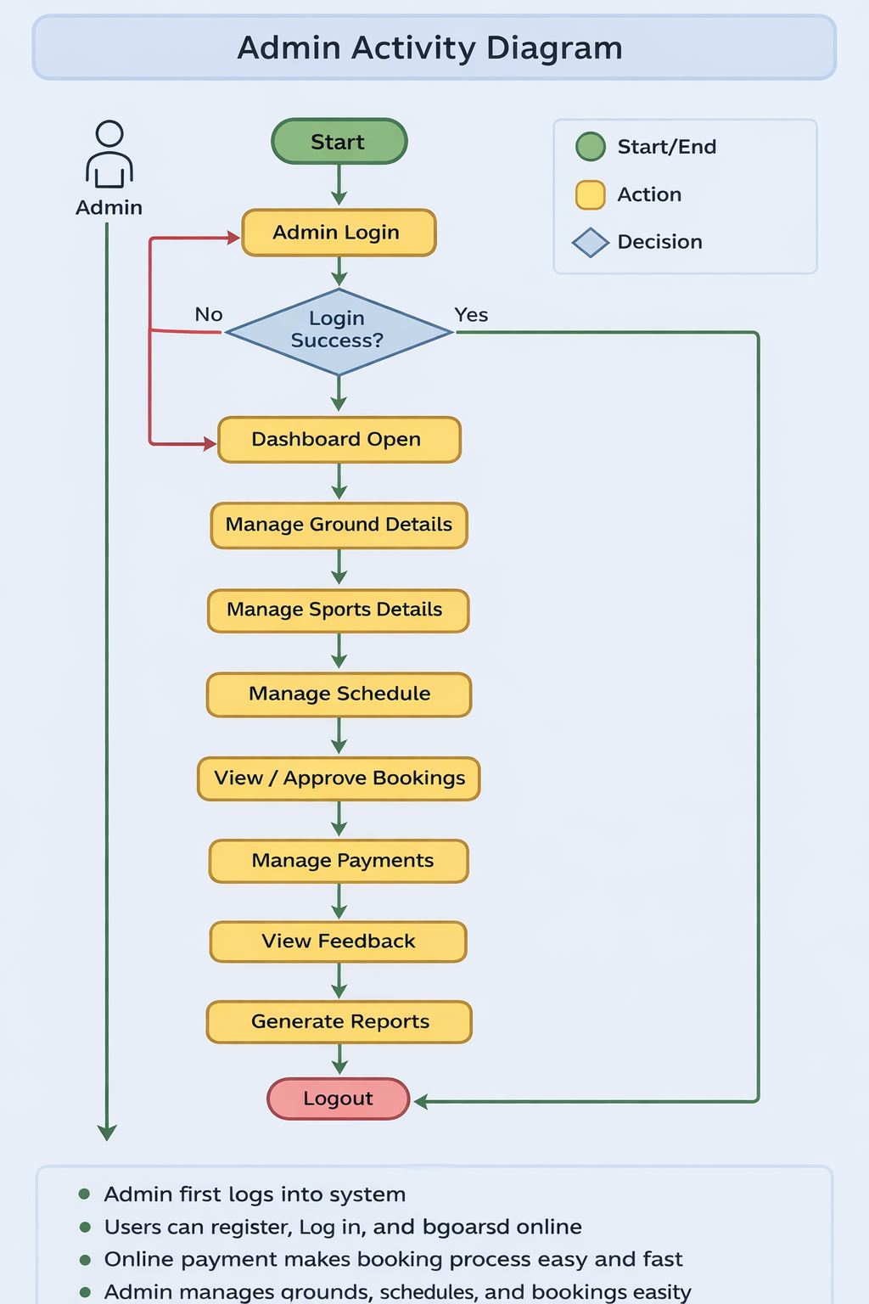

Slide 13
Data Dictionary
USER – Stores user information for registration and booking activities.
LOGIN – Manages username, password, and user role for system access.
SPORTS – Contains details of different sports available in the system.
GROUND – Stores information about sports grounds and their locations.
BOOKING – Maintains records of ground bookings made by users.
PAYMENT – Stores payment details related to bookings.
SCHEDULE – Manages available dates and time slots of grounds.
FEEDBACK – Stores feedback given by users about the system or service.
ADMIN – Contains administrator details for managing the system.

Slide 14
Thank you

